Slide 1
'[N]othing like the rest of Holland':
punk in Groningen
By Dr Kirsty Lohman
University of Warwick

Slide 2
Format of Presentation
Project information
Groningen
Locality and Identity
Groningen’s Squatting history
Unity between subcultures
Supporting and building the local scene
Nostalgia
Punk connectedness and Touring
- Groningen and Germany
- Groningen and America
Conclusion

Slide 3
Project Information
Ethnographic research project.
Data collected between July 2010 and February 2011.
Data collected across the Netherlands.
Groningen data set:
15 semi-structured interviews
Age range: 23-58
4 women, 11 men
Pseudonyms used
Full Netherlands data set:
33 interviews
Age range: 21-65
5 women, 28 men

Slide 4
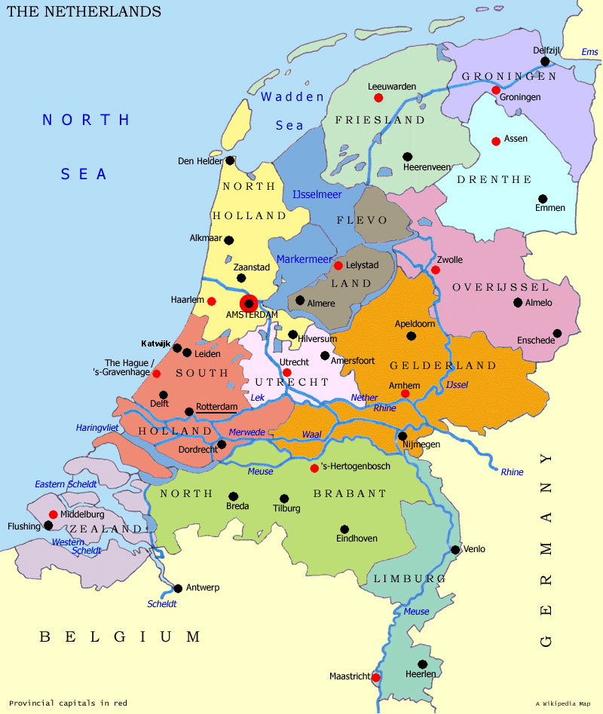
Groningen
Groningen is ‘isolated’ (Kosta).
Amsterdam
Utrecht
The Hague
Nijmegen
Rotterdam
Tilburg
Sander (Amsterdam) will travel to ‘Nijmegen, Utrecht, Tilburg; if there’s a cool band then we’ll hop in the car, or on a train, no problem!’.

Slide 5
Locality and Identity
Mobility affects locality.
‘[In Utrecht] you always get the same people coming, and often […] people from Nijmegen turn up and from Amsterdam and there is a sort of a solid base of people coming to the shows’ (Gregor).
‘Translocality’ (Hodkinson, 2002).
‘Sense of space/myth of place’ (Shields, 1991)
Building a local identity in Groningen:
Groningen’s squatting history
Unity between subcultures
Supporting and building the local scene
Nostalgia

Slide 6
Groningen’s Squatting history
Groningen squats: WNC (c.1970-1990) and ORKZ (1979-).
‘We were kind of known throughout Holland that we didn’t give a fuck so, you know, so they always put us up at the front of the demonstration so even if there’s like fights with cops or with skinheads or something we’ll just fucking kick the shit of them you know!’(Bram).
‘People in Amsterdam looked down upon us’ (Henk).
‘I think everybody here will tell you the same, [the] Groningen punk scene is nothing like the rest of Holland, it’s always been a bit more - more drugs, more drink, more bands, more partying; but also more fights, we’ve had a fucking rough time here in squats with cops and students but also with hooligans you know (Bram).

Slide 7
Unity between subcultures
Mixing socially
You can’t run a pub with just 10 fucking metalheads showing up, you know, you need to get all the other people in as well! And it works really well cos it turns out that we all get on really well, a lot better than we expected! (Bram)
- Mixing musically
‘I think for all music and all musicians in Groningen there’s a difference [from the rest of the country]; because the city’s pretty small. So whether you play jazz, or whether you play funk or hardcore, punkrock or pop; whatever you do, we all know each other! All these people, they’re all musicians and they all gather at the Viadukt which is place which has lots of rehearsal space’ (Henk).
‘The difference between the nuclear plant and the battery!’ (Kosta).

Slide 8
Supporting and Building the local scene
‘There really is a collaboration between DIY, punk and squatter scenes and the more normal places; bars, Crowbar. These are per se two different worlds, but if needbe then they work together, I think that it’s lovely to see’ (Jolanda).
Café Vera’s DIY/punk links.
The Crowbar is set up to provide a space for people.
‘We thought that we needed a small venue for alternative bands because there wasn’t anything like that, especially for local bands’(Lotte).

Slide 9
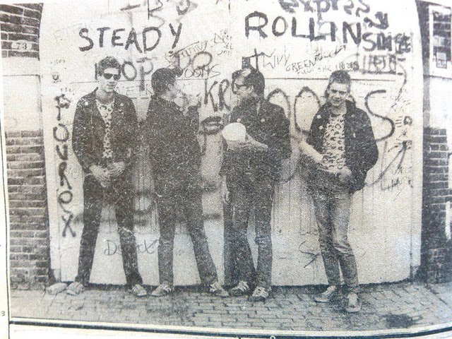
Nostalgia
The Simplon Punks Reunion
Super-local punk identity

Slide 10
Punk Connectedness and Touring
‘If I travel further it’s usually if I’m playing myself’(Jolanda).
‘Holland is too small [to do shows every weekend]’ (Theo).
‘After the first demo we started playing outside of our own town. And then after our first album we started playing all over the country and eventually we went to other countries’ - ‘our first gig abroad was in Belgium in Oostende and we really did a lot of gigs in Belgium’- ‘we went to England, well we had some shows in France, […] But we also went to Germany, Austria, Slovenia, Italy, Switzerland, Hungary, Poland, Romania [for] one gig, Slovakia, Norway and Sweden’ (Larry).
- Reciprocity and relationships in touring networks.

Slide 11
Groningen and Germany
‘You can compare [Groningen] a lot more with I suppose the German punk scene, which is not that weird because we’re more or less on the border. When the first big city in Germany is Oldenburg, which is a lot closer than the first big city in Holland, you know, so... We’ve always – we’re a bit more international – none of our bands played a lot in Holland either, we always went over the border straight away’ (Bram).

Slide 12
Groningen and the United States
Andre, Nijmegen: ‘America is really hard to go to for a tour’.
Jolanda, Groningen: ‘there are very many bands who go on tour to America really quickly’.
The Dead Moon - Café Vera connection.
Portland’s ‘punk hearted’ ‘rock and roll’ scene (Jaap) influences Groningen’s punk.

Slide 13
Conclusion
The shift to focusing on subcultures in a globalised world.
- ‘Translocal’ subcultures (Hodkinson, 2002).
The unequal opportunities that globalisation brings (Massey, 1993).
We must remember to focus on the very different local contexts that all contribute to the multi-faceted global punk scene.
Thank you for listening!

