Slide 1
‘Anarchy in the UK’ to ‘Dutch Disease’:
Punk from Britain to The Netherlands
By Dr Kirsty Lohman
University of Warwick

Slide 2
Project Information
Historically contextualised ethnography.
Data collected between July 2010 and February 2011.
Data set
33 interviews:
Age range: 21-65
Archival data
Participant observation
Pseudonyms used in presentation.

Slide 3
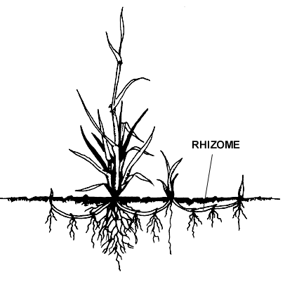
‘Centre’ / ‘Periphery’ in punk
Authenticity in punk: there is ‘a distinction between originals and hangers-on’ (Hebdige, 1979:122).
Globalisation and ‘Centre’ / ‘Periphery’ distinction (Shils, 1975; Wallerstein, 1974)
In punk UK and US are positioned as ‘centres’ and the rest of the world as ‘peripheral’ (O’Connor, 2004).
Rhizome:

Slide 4
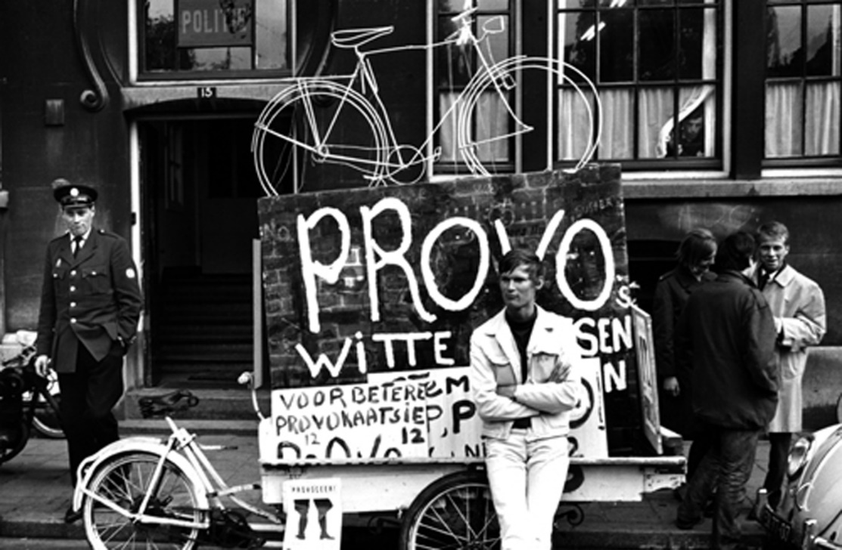
Dutch cultural context
1965 – Provo
Revolution of the PROVOtariat’: ‘beatniks, nozems, provos, students, artists, criminals’ (van Stokrom, 2002: 41).
Provo and the ‘White Plans’

Slide 5
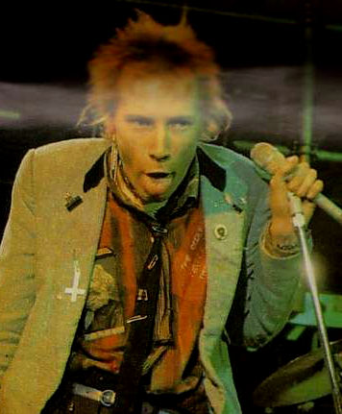
Anarchy [comes to] The Netherlands
Sex Pistols in The Netherlands
January 4th – 8th 1977.
4th: Disco Circus TV appearance
5th: Amsterdam gig
6th: Rotterdam gig
7th: Amsterdam gig
‘They had the Sex Pistols on [TV]. And I could […] see like Johnny Rotten in front, throwing chairs and looking like he was completely on speed or whatever, going crazy, and I was just like “what a bunch of idiots”’ (Theo).

Slide 6
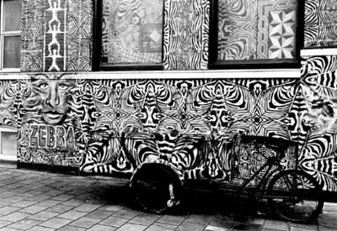
Anarchy [comes to] The Netherlands
First Dutch punk bands were mimetic and shifted from playing pub rock to punk.
First bands?
Ivy Green and Flyin’ Spiderz (Goossens and Vedder, 1996)
Similar to UK, punk was first entwined with the art scene.
Rotterdam: Amsterdam:
Rondos at Diana Ozon and
Huizeschoonderloo Hugo Kaagman at
Gallerie Anus at Zebrahuis

Slide 7
‘Dutch Disease’
(by The Ex, 1982)
Politics and punk – early punk in UK and NL is not homogenous.
Crass and The Clash and more popular in The Netherlands.
The Ex and Rondos are highly political.

Slide 8
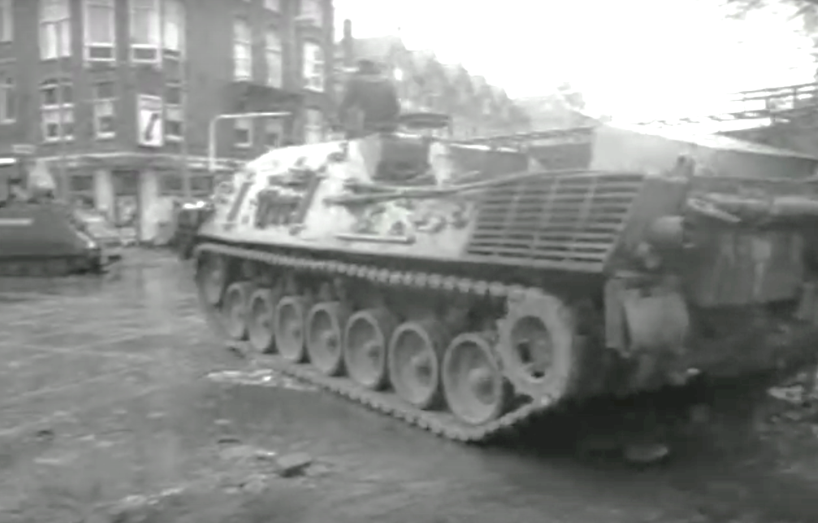
Squatting and Politics
[The Wijers squat had] a restaurant, bar, café, cinema, performance spaces, night store, art gallery, convenience store, acupuncture clinic, theatre groups, rehearsal studios for musicians, artist studios, printing press, nursery, skateboard park, theatre, music electronics workplace, wood recycling centre, fine wood dealer, two woodworking studios, guitar builder, piano restoration, wind energy workplace, bicycle repair, ceramics workplace, audiovisual workplace with a school, taxi collective, delivery service, cargo bicycle rental, silk screening, photography collective, repair services for electronics and clothing, an environmentally friendly store, recycled products store, architecture firm, press bureau, accounting office, book store and printer, Aikido school, tea and herb store, windmill services, first aid services, and information offices for environmental and activist groups [as well as a radio station] (Owens, 2009: 136-7).
Picture: the use of tanks to clear the Vondelstraat squat, 1980.

Slide 9
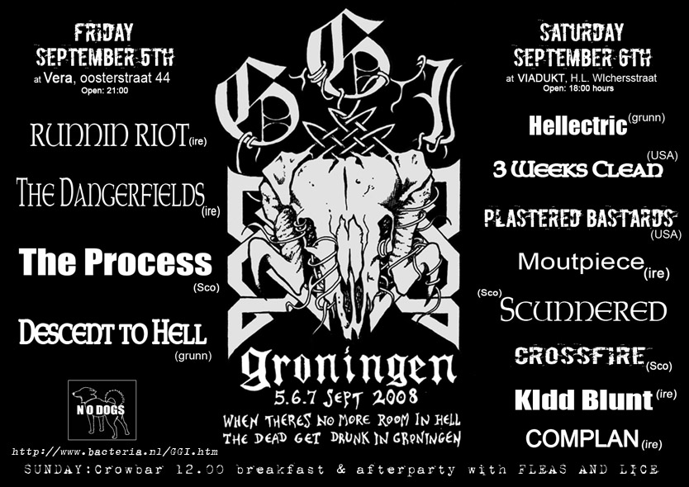
Rhizomes between NL and UK
1983 - The Ex tour Britain
1984 – The Ex support the Miner’s Strike
The relationship between The Ex and the Dog Faced Hermans highlights the complexity of punk cultural influence.
GGI Festival
- Groningen
- Glasgow
- Ireland

