Slide 1
ANOK4U2? Crass, Rondos and the Politics of Punk, 1977–84
Kirsty Lohman and Matt Worley

Slide 3
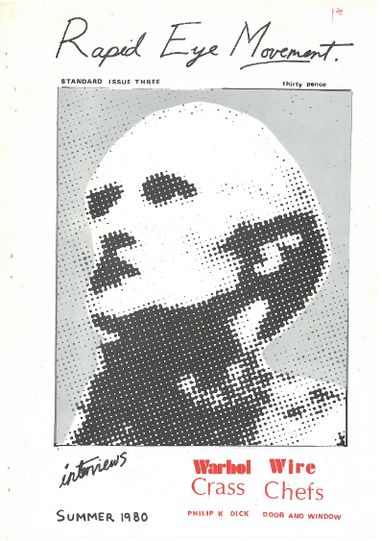
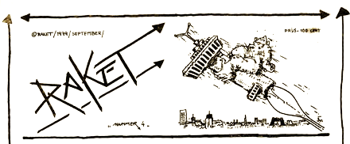
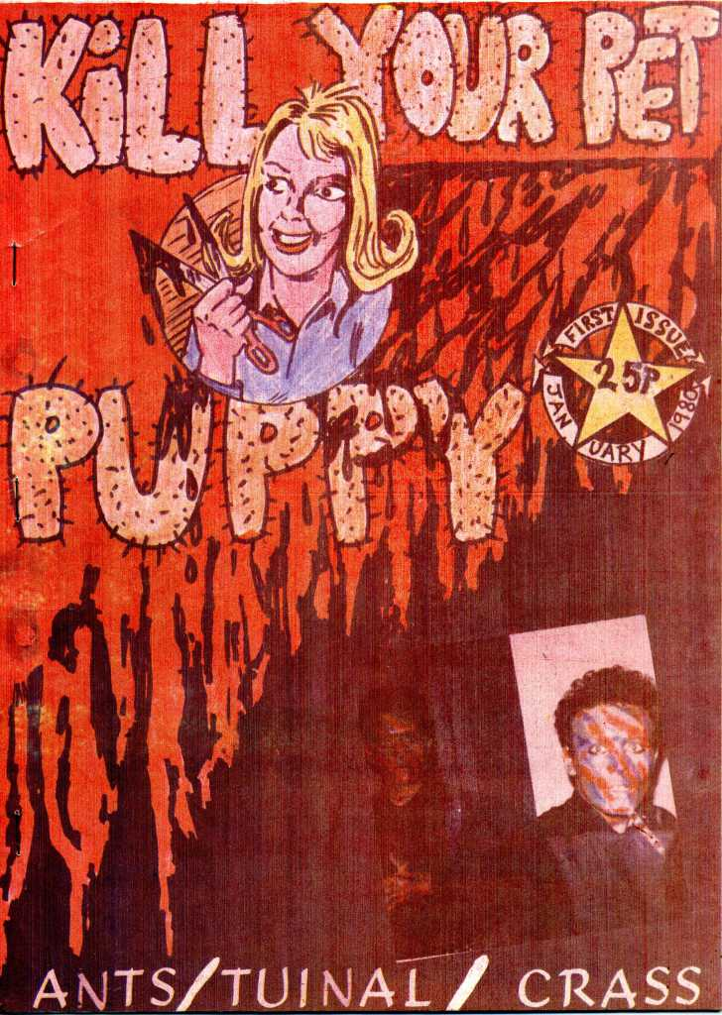
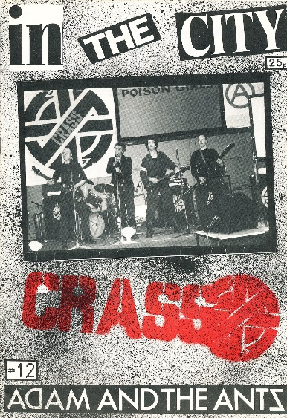

Slide 4
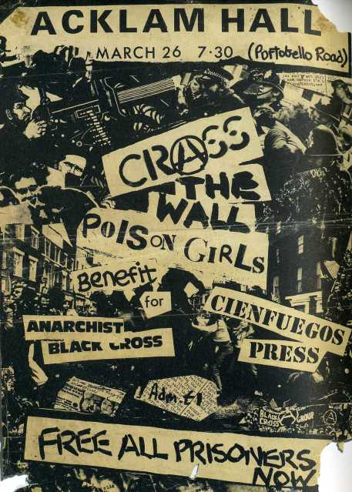
Crass’ politics
Gee Vaucher: ‘We’re anarchists in thought’
Andy Palmer: ‘But when you start trying to classify us, well that’s exactly what we’re trying to get away from.
Penny Rimbaud: ‘Anarchy is thinking for yourself […] We don’t want any revolution. We just want to live our lives the way we want to’.

Slide 5
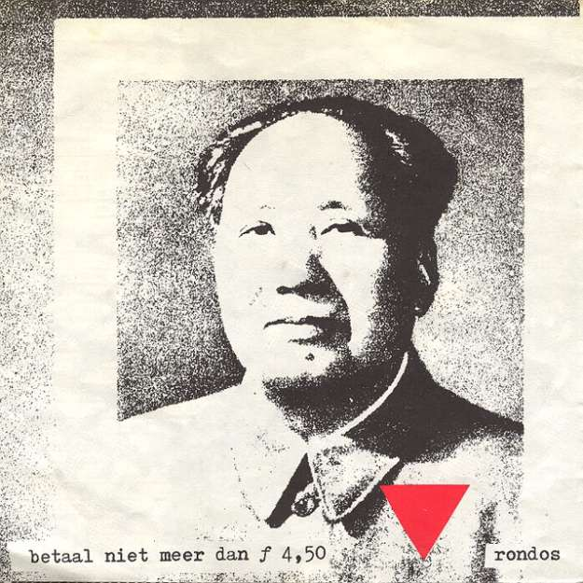
Rondos’ politics
no establishment’s art no deadman’s heart no bourgeois illustrations no ruling class frustrations but art out on the street a new heartbeat a new art passion class war aggression ‘A Black & White Statement’(King Kong, 1980)

Slide 6
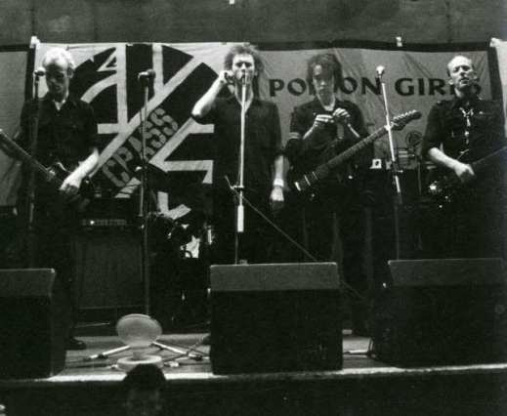
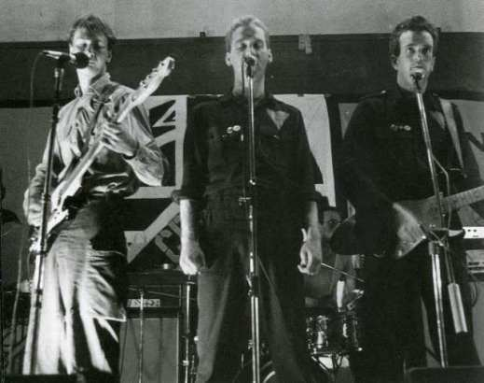
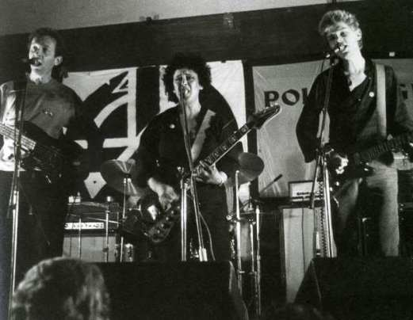
Conway Hall, London 8 September 1978
Soundcheck

Slide 7
Pacifism or Violence?
Penny Rimbaud: ‘pacifism never meant being passive. It’s just a general term meaning don’t look for answers to your problems in violence’

Slide 8
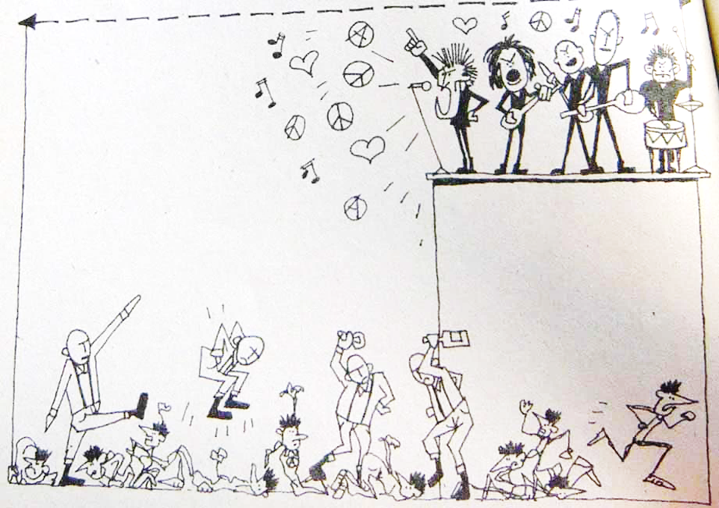
Pacifism or Violence?
Rondos: ‘We believe that sometimes it might be necessary to use violence, for example, in order to counter 20 fascists beating up 600 punks such as at Crass’ gigs’
Rondos: ‘We believe that sometimes it might be necessary to use violence, for example, in order to counter 20 fascists beating up 600 punks such as at Crass’ gigs’

Slide 9
Crass & Poison Girls, ‘Bloody Revolutions’(Crass Records, 1980)
You talk of overthrowing power with violence as your tool You speak of liberation and when the people rule […] Just another set of bigots with their rifle-sights on me
Rondos, ‘Which Side Will You Be On?’ (King Kong, 1980)
On the day this system falls On that day with our backs against the wall […] When they protect property with guns […] which side will you be on?

Slide 11
For more:
Lohman and Worley (2018), ‘Bloody Revolutions, Fascist Dreams, Anarchy and Peace: Crass, Rondos and the Politics of Punk, 1977–84’, Britain and the World, 11(1): 51-74.
Thanks for listening
Any questions?

